Slide 1



Medical Insurance Premium Prediction

Slide 2

Medical insurance premium prediction (EDA and RF)
Submitted to the Savitribai Phule Pune University, Pune in the partial fulfillment for the award of the degree of bachelor of engineering in computer engineering
Under the guidance of
Prof.S.S.Nimbalkar
Department of computer engineering svpm's college of engineering Malegaon(bk) a/p-malegaon(bk)-413115, tal. Baramati, dist. Pune

Slide 3
TABLE OF CONTENTS
Introduction 01
02
04
05
Conclusion
Problem Statement
References
Output
03

Slide 4
Introduction
Our project contains a user's medical history in the form of whether they have a specific condition or not, their age, height, weight, etc. along with the premium they have to pay in INR for insurance.
MVC

Slide 5
PROBLEM STATEMENT
Insurance is a policy that eliminates or decreases loss costs occurred by various risks. Various factors influence the cost of insurance. So, to forecast premium cost using Machine learning algorithm becomes a better way.

Slide 6
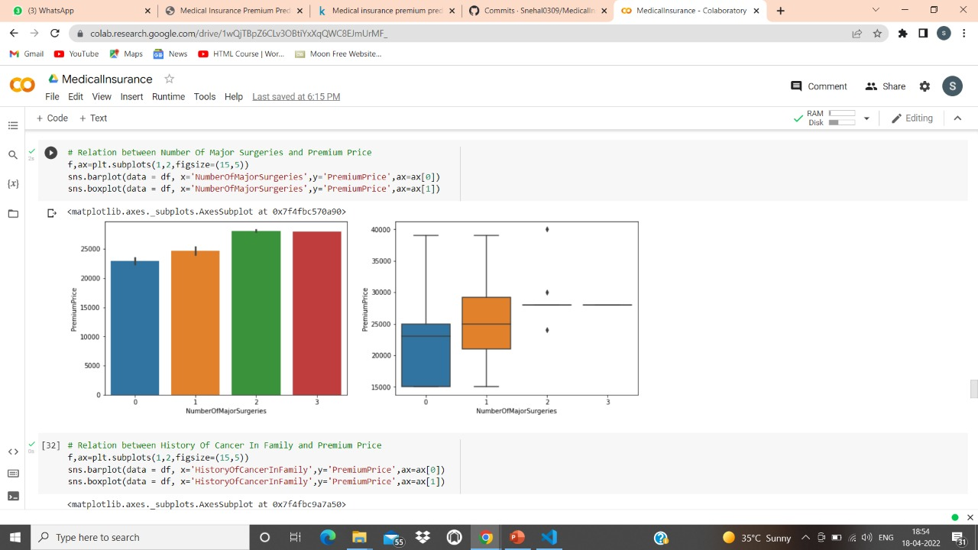
Output

Slide 7
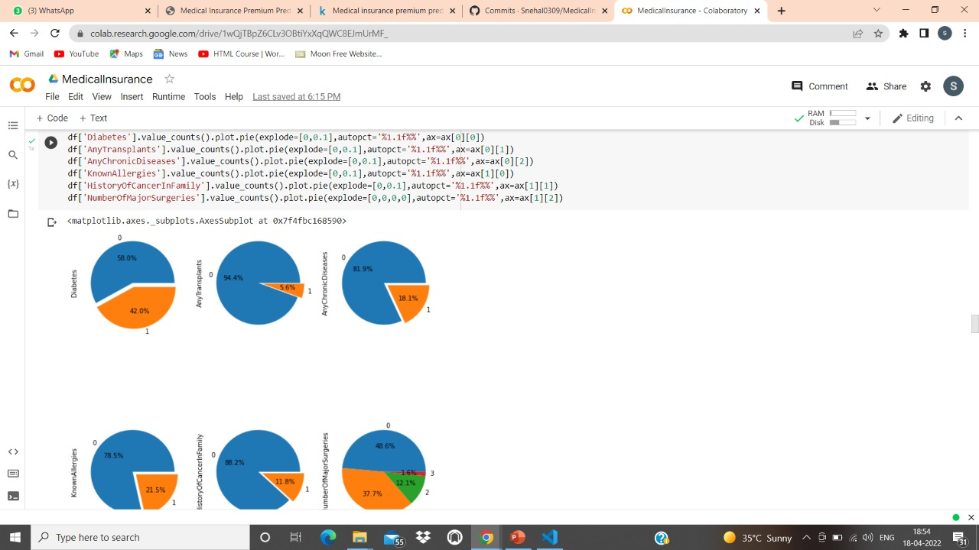
Output

Slide 8
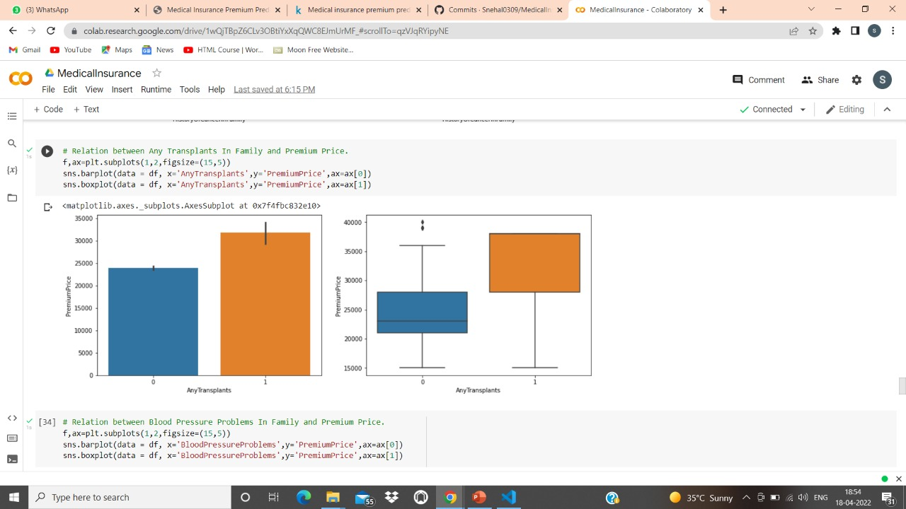
Output

Slide 9
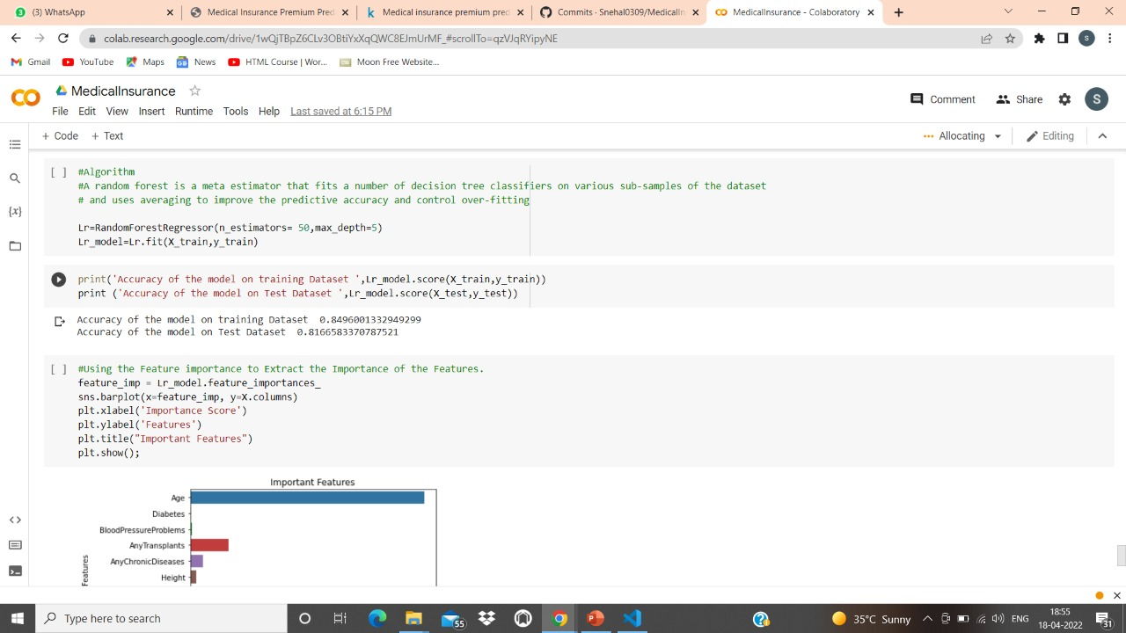
Output

Slide 10
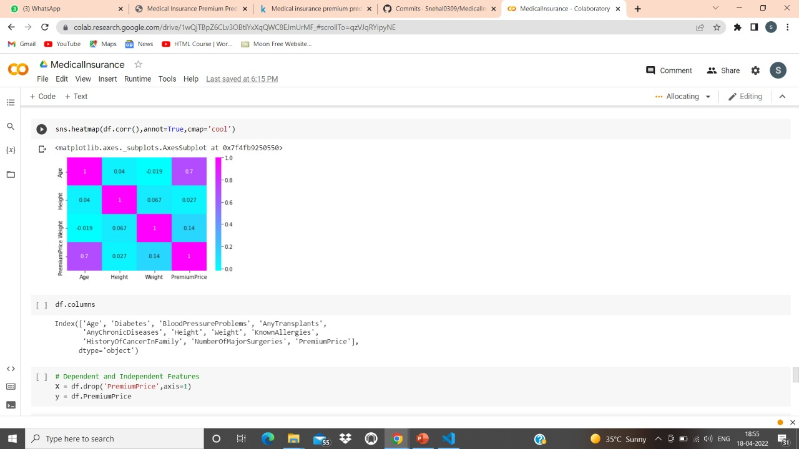
Output

Slide 11
Conclusion
In this study, we determined what factors play an important role in determining the premium of the user

Slide 12
References
Websites used:
www.Kaggle.com
https://colab.research.google.com

Slide 13
THANK YOU

